Slide 1
Dave Matthews: Don’t Drink the Water
Come out come out No use in hiding Come now come now Can you not see? There's no place here What were you expecting Not room for both Just room for me So you will lay your arms down Yes I will call this home Away away You have been banished Your land is gone and given me And here I will spread my wings Yes I will call this home
What's this you say? You feel a right to remain? Then stay and I will bury you What's that you say Your father's spirit still lives in this place I will silence you Here's the hitch Your horse is leaving Don't miss your boat It's leaving now And as you go I will spread my wings Yes I will call this home I have no time to justify to you Fool, you're blind, move aside for me All I can say to you my new neighbor
Is you must move on or I will bury you Now as I rest my feet by this fire Those hands once warmed here I have retired them I can breathe my own air I can sleep more soundly Upon these poor souls I'll build heaven and call it home Cause you're all dead now I live with my justice I live with my greedy need I live with no mercy I live with my frenzied feeding I live with my hatred I live with my jealousy I live with the notion That I don't need anyone but me Don't drink the water Don't drink the water There's blood in the water Don't drink the water
Notes:
https://www.youtube.com/watch?v=psIuidkkLjI

Slide 2
I Will Fight No More, Forever
Tell General Howard I know his heart. What he told me before, I have it in my heart. I am tired of fighting. Our Chiefs are killed; Looking Glass is dead, Ta-Hool-Hool-Shute is dead. The old men are all dead. It is the young men who say yes or no. He who led on the young men is dead. It is cold, and we have no blankets; the little children are freezing to death. My people, some of them, have run away to the hills, and have no blankets, no food. No one knows where they are - perhaps freezing to death. I want to have time to look for my children, and see how many of them I can find. Maybe I shall find them among the dead. Hear me, my Chiefs! I am tired; my heart is sick and sad. From where the sun now stands I will fight no more forever.
~Hin-mah-too-yah-lat-kekht, Chief Joseph (Thunder Traveling to the Loftier Mountain Heights) - 1877

Slide 3
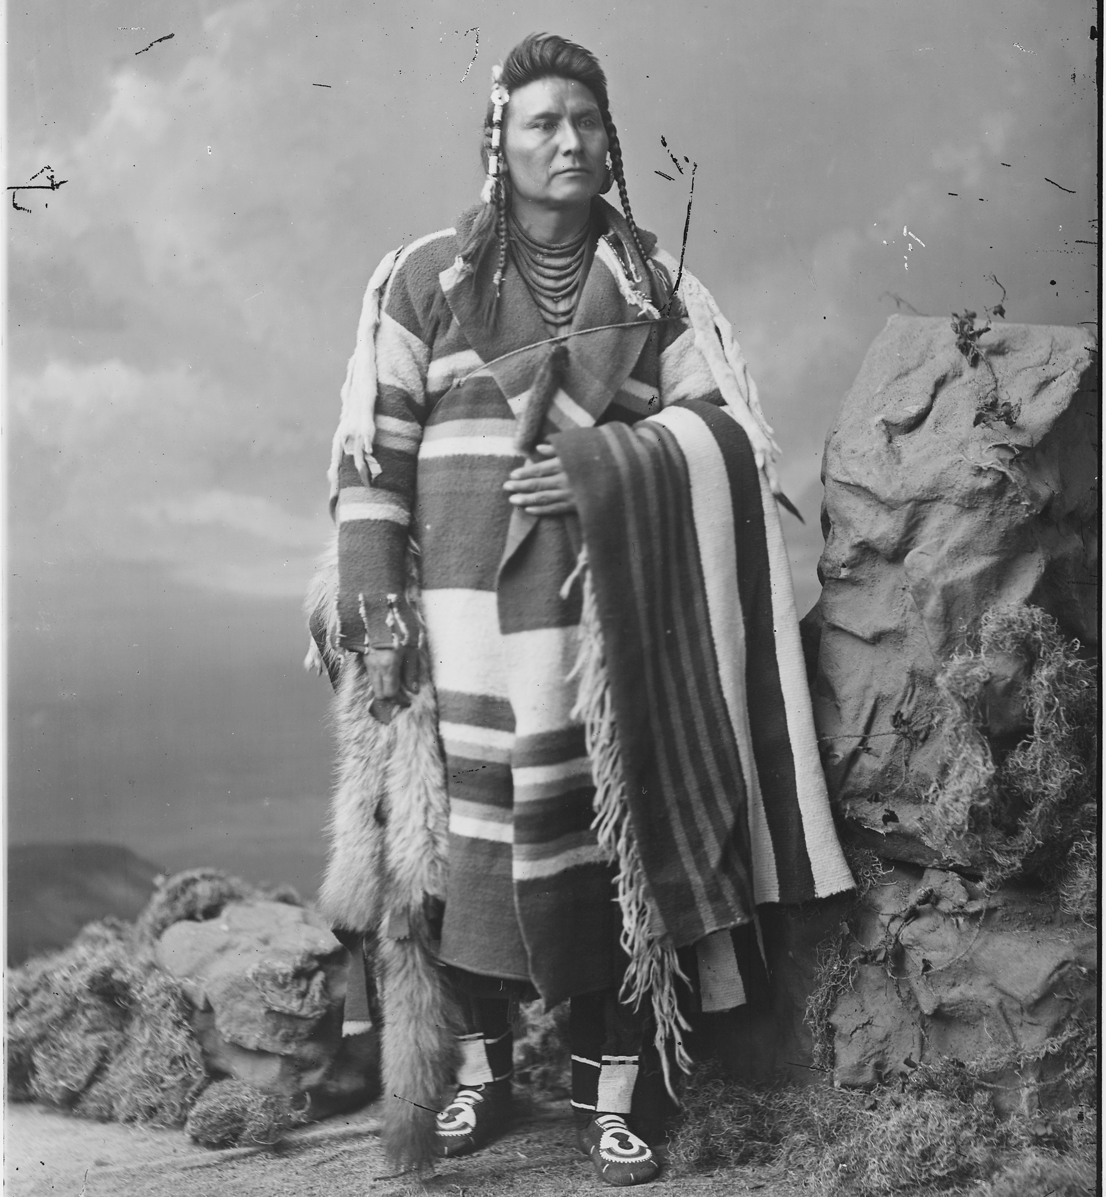
Notes:
Nez Perce' chief; full-length, standing, by William H. Jackson, before 1877

Slide 4
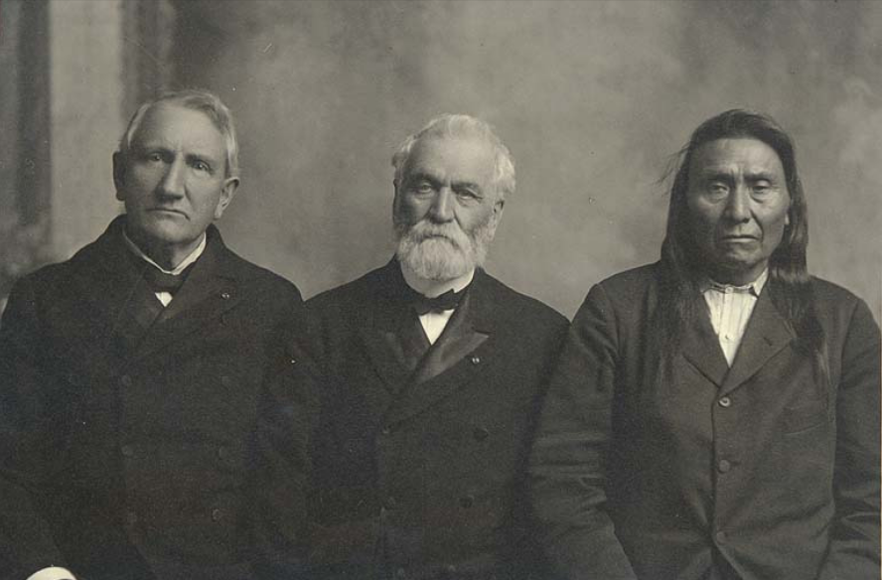
Notes:
Nez Perce Chief Joseph with General O.O. Howard & Colonel Pratt, 1904

