Slide 1
Working Conditions in the Gilded Age
Document Analysis

Slide 2
Conditions
While going through the PowerPoint, write down notes about working conditions that stand out to you from the documents and the photos.
When you are finished, write a journal entry from the perspective of someone working in a factory. Include:
Reasons why you put up with the conditions
Feelings about the conditions
What you think you could do about it.

Slide 3
Camella Teoli Video
Click on the link to view the video “A Child on Strike”
https://youtu.be/Gp_3gHU-K6o

Slide 4
“Breaker Boys” by John Spargo
Work in the coal breakers is very hard and dangerous. Crouched over chutes, the boys sit hour after hour picking out slate and other waste from the coal as it rushes past to the washers. Because they sit crouched for many hours, most of the boys become more or less bent-backed, like old men.
The coal is hard, and accidents to the hands-such as broken or crushed fingers-are common. Sometimes there is a worse accident: a terrified shriek is heard, 'and a boy is mangled in the machinery or disappears in the chute to be picked out later, smothered and dead. Clouds of dust fill the air and are inhaled by the boys, leading to asthma and other breathing problems.
I once stood in a breaker for half an hour. I tried to do the work a 12-year-old boy was doing for 10 hours each day for 60 cents a day. The gloom was horrible. Outside, the sun shone brightly, the air was clear. Within the breaker there was blackness. Clouds of deadly dust covered everything. The harsh grinding of the machinery and the ceaseless rushing of coal through the chutes filled the ears,
From the breakers, the boys graduate to the mine depths. Here, the work is more dangerous. In the mines of West Virginia, boys of 9 or l0 are frequently employed. I met one little fellow 10 years old who was employed as a trap boy. He would sit alone in a dark mine passage, standing in water or mud that covered his ankles. He was often chilled by the winds that rushed in when he opened the trap door for the mules to pass through. He worked 14 hours straight, waiting, opening and shutting the door and wait again, for 60 cents a day…

Slide 5
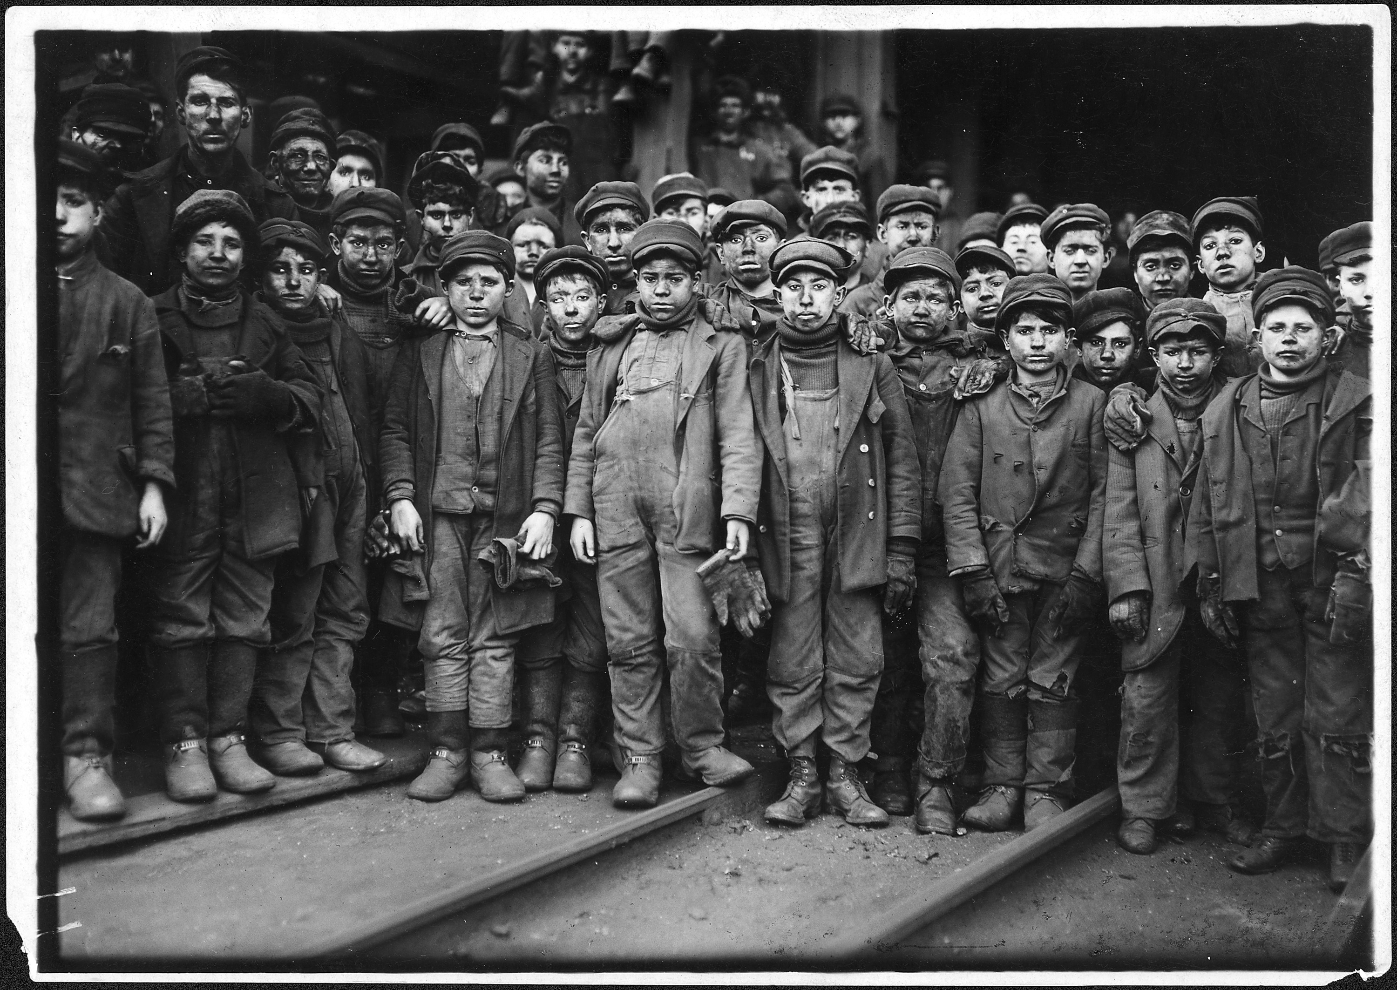

Slide 7
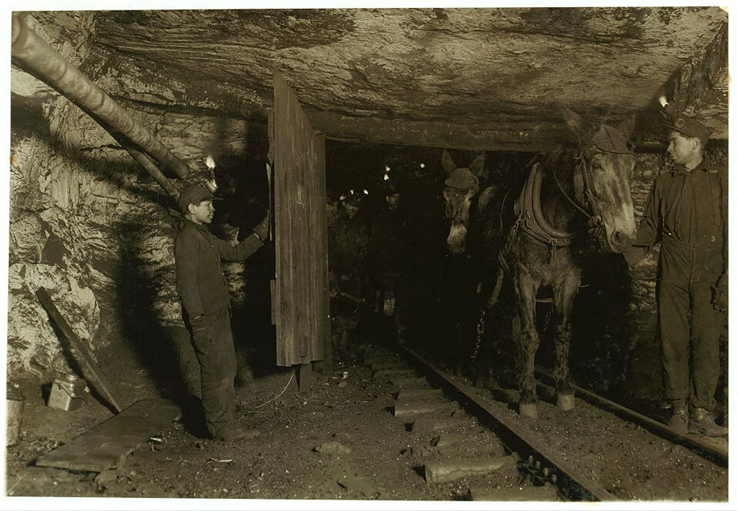

Slide 8
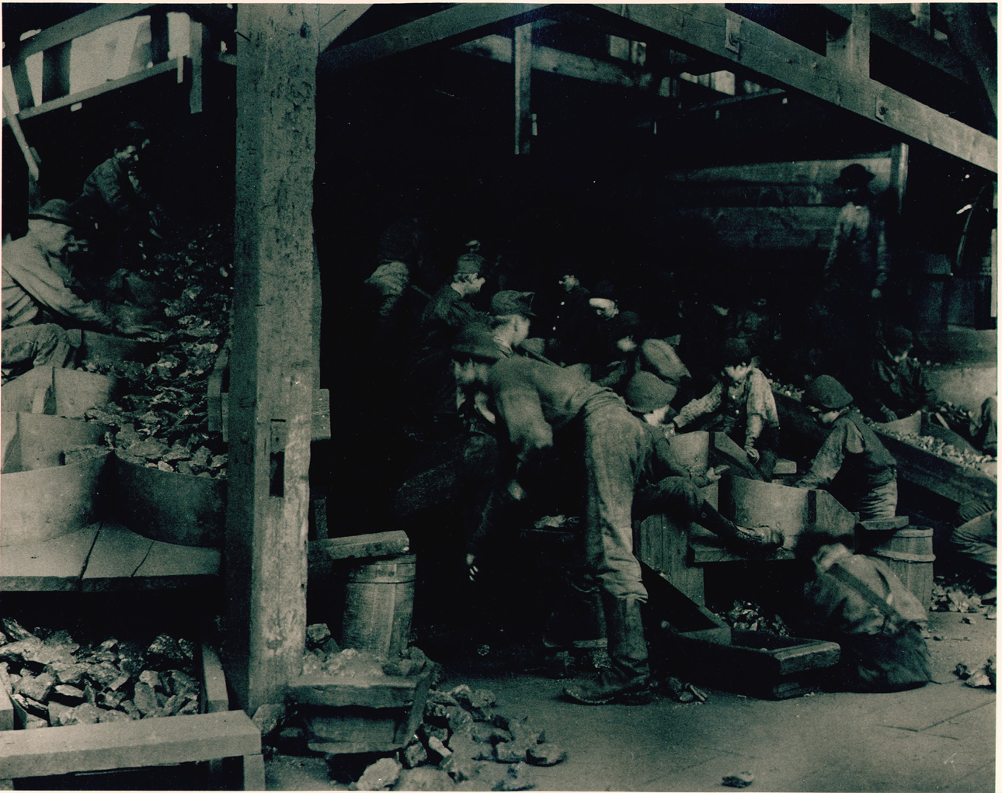

Slide 9
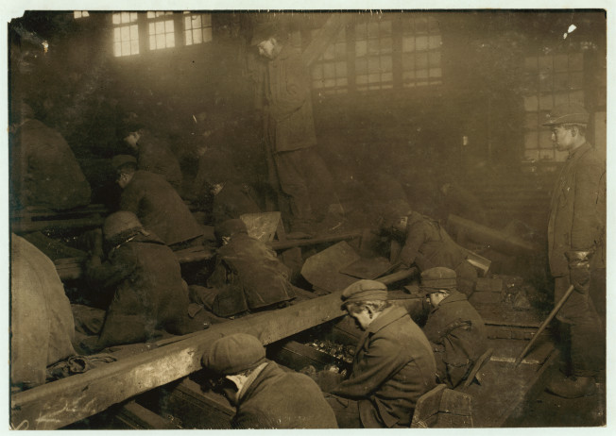

Slide 10
Account of Sadie Frowne
Two years ago I came to this place, Brownsville, where so many of my people are, and there I have friends. I got work in a factory making underskirts-all sorts of cheap underskirts...I earned $4.60 a week and lived on $2.00 a week, the same as before... All the hands get different amounts, some as low as $3.60 and some of the men as high as $16 a week.
I get up at half-past five o'clock every morning and make myself a cup of coffee on the oil stove. I eat a bit of bread and perhaps a bit of fruit and then go to work. Often ·I get there soon after six o'clock so as to be in good Time tho[ugh] the factory does not open till seven. I have heard that there is a sort of clock that calls you at the very time you want to get up, but I can't believe that because I don't see how the clock would know.
At seven o'clock we all sit down to our machines and the boss brings to each one the pile of work that he or she is to finish during the day, what they call in English their “stint”. This pile is put down beside the Machine and as soon as a skirt is done it is laid on the other side of the machine. Sometimes the work is not finished by six o'clock and then the one who is behind must work overtime. Sometimes one is finished ahead of time and gets away at four or five o'clock, but generally we are not done till six o’clock.
The machines go like mad all day, because the faster you work the more money you get. Sometimes in my haste I get my finger caught and the needle goes right through it. It goes so quick, though, that it does not hurt much. I bind the finger up with a piece of cotton and go on working, all have accidents like that. Where the needle goes through the nail it makes a sore finger, or where it splinters the bone it does much harm. Sometimes a finger has to come off. Generally, though, one can be cured by a salve..

Slide 11
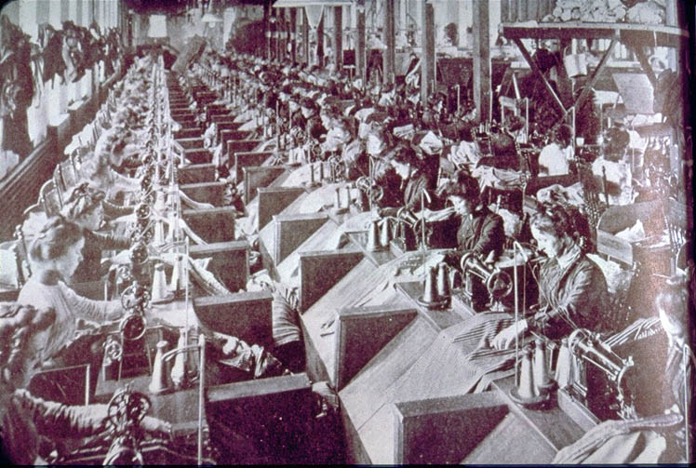

Slide 12
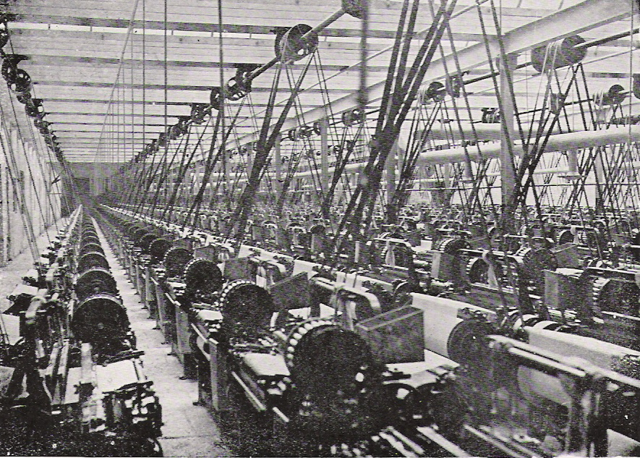

Slide 13
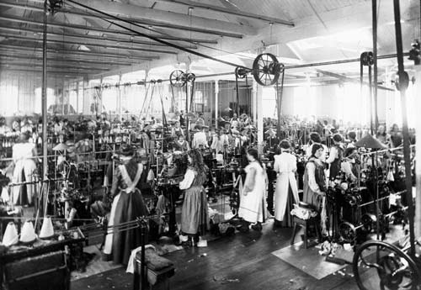

Slide 14
“Mother” Mary Harris Jones in the Cotton Mills
Little girls and boys, barefooted, walked up and down between the endless rows of spindles, reaching thin little hands into the machinery to repair snapped threads. They crawled under machinery to oil it. They replaced spindles all day long, all day long; night through, night through. Tiny babies of six years old with faces of sixty did an eight-hour shift for ten cents a day. If they fell asleep, cold water was dashed in their faces; and the voice of the manager yelled above the ceaseless racket and whir of the machines. Toddling chaps of four years old were brought to the mills to “help” the older sister or brother’ of ten years but their labor was not paid. The machines, built in the north, were low for the hands of little children.
At five-thirty in the morning, long lines of little grey children came out of the early dawn into the factory, into the maddening noise, into the lint filled rooms. Outside the birds sang and the blue sky shone. At the lunch half-hour, children would fall to sleep over their lunch of cornbread and fat pork. They would lie on the bare floor and sleep. Sleep was their recreation, their release, as play is to the free children. The boss would come along and shake them awake. After the lunch period, the hour-in grind, the ceaseless running up and down between the whirring spindles. Babies, tiny children!
Often the little ones were afraid to go home alone in the night. Then they would sleep till sunrise on the floor. That was when the mills were running a bit slack and the all-night worked shorter hours. I often went home with the little ones after the day’s work was done or the night shift went off duty. They were too tired to eat. With their clothes on, they dropped on the bed . . . to sleep, to sleep ... the one happiness these children know.
But they had Sundays, for the mill owners and the mill folks themselves were pious. To Sunday School went the babies of the there to hear how God had inspired the mill owner to come down and build the mill, so as to give His little ones work that they might develop into industrious, patriotic citizens and earn money to give to the missionaries to convert the poor unfortunate heathen Chinese.

Slide 15
“Mother” Mary Harris Jones in the Cotton Mills
…I left Cottondale and went to Tuscaloosa where I got work in a rope factory. This factory was run also by child labor. Here, too, were the children running up and down between spindles. The lint was heavy in the room. The machinery needed constant cleaning. The tiny, slender bodies of the little children crawled in and about under dangerous machinery, oiling and cleaning. Often their hands were crushed. A finger was snapped off.
A father of two little girls worked a loom next to the one assigned to me. “How old are the little girls?” I asked him.
“One is six years and ten days,” he said, pointing to a little girl, stoop shouldered and thin chested who was threading warp, “and that one,” he pointed to a pair of thin legs like twigs, sticking out from under a rack of spindles, “that one is seven and three months.”
“How long do they work?”
“From six in the evening till six come morning.”
“How much do they get?”
“Ten cents a night.”
“And you?”
“I get forty [cents].”
In the morning I went off shift with the children. They stumbled out of the heated atmosphere of the mill, shaking with cold as they came outside. They passed on their way the long grey line of little children with dinner pails coming in for the day’s shift.
They die of pneumonia, these little ones, – bronchitis and consumption. But the birth rate like the dividends is large and another hand is ready to tie the snapped threads when a child worker dies.

Slide 16
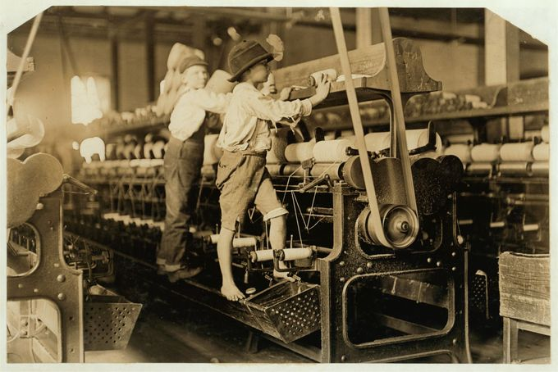

Slide 17
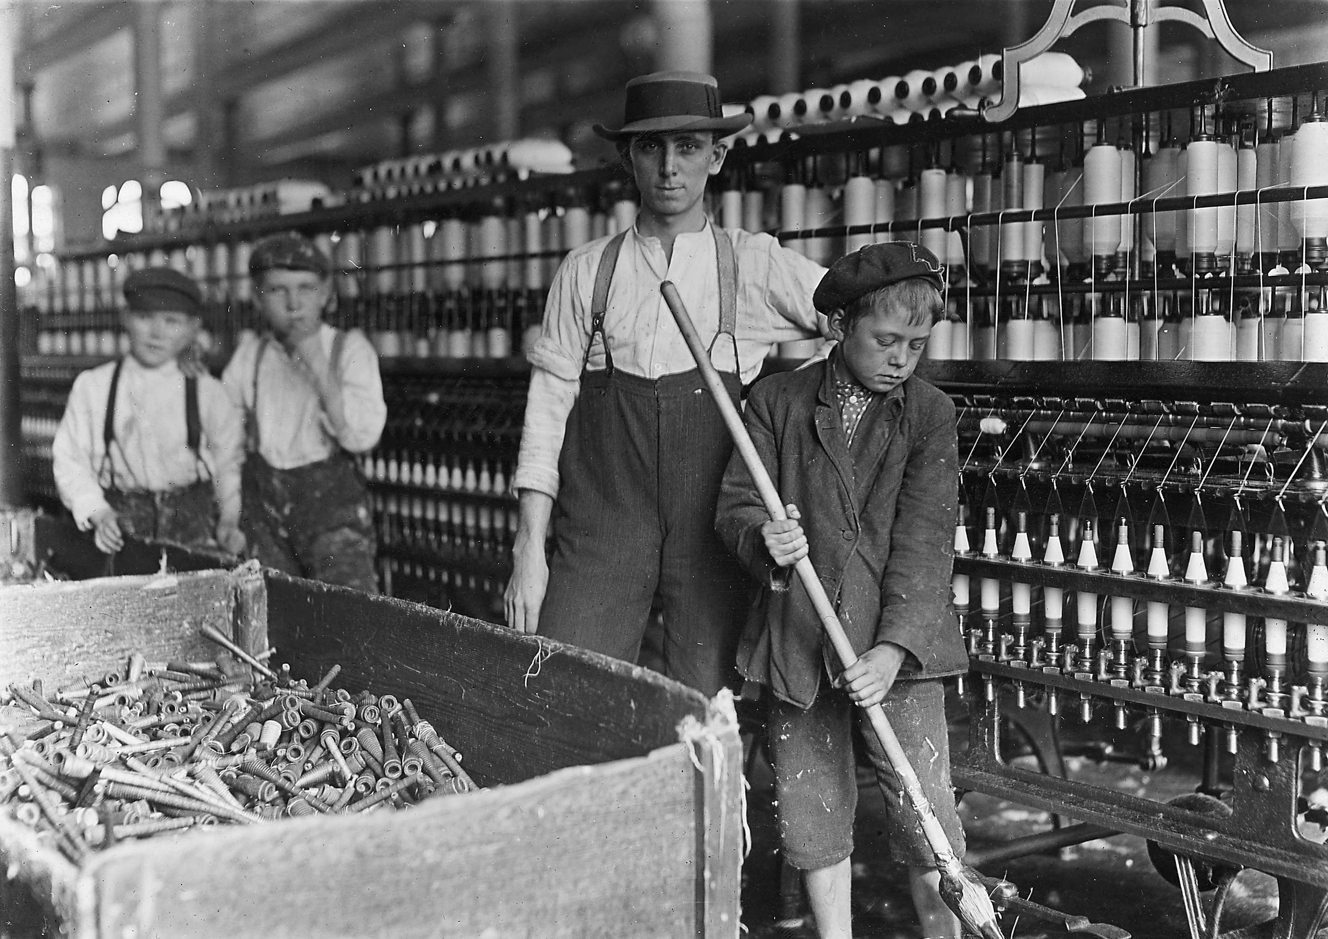

Slide 18
